Slide 1
AuLA 18
Modelação Ecológica
11 Dezembro 2018 – 14:00-17:00 – sala 2.2.14
Tiago A. Marques

Slide 2
Amanhã!

Slide 3
Palestra Quinta FEIRA 6 de Dezembro 14:15
Por videoconferencia – NÃO OCORREU POR RAZÕES TÉCNICAS – mas agora slides no FENIX e video no YOUTUBE
Speaker: Theoni Photopoulou (University of St Andrews)
Title: Two applications of hidden Markov models for animal movement data: the highs and lows of sampling resolution
Abstract: Hidden Markov models are now commonly used for modelling time series of animal locations or other animal movement data. They are proving to be an extremely useful tool for understanding the evolution of various movement metrics through time. One of the strengths of HMMs are that they offer a core framework that is relatively easy to adapt and extend. I will present two applications that illustrate the diversity of problems that HMMs can be used to address within the field of animal movement. I will talk about a model for sparse location data from sharks, collected using passive acoustic telemetry, and a model for dive variables from a high spatial resolution dataset on grey seals and how HMMs can be used to make inferences about diving behaviour over longer time scales.

Slide 4
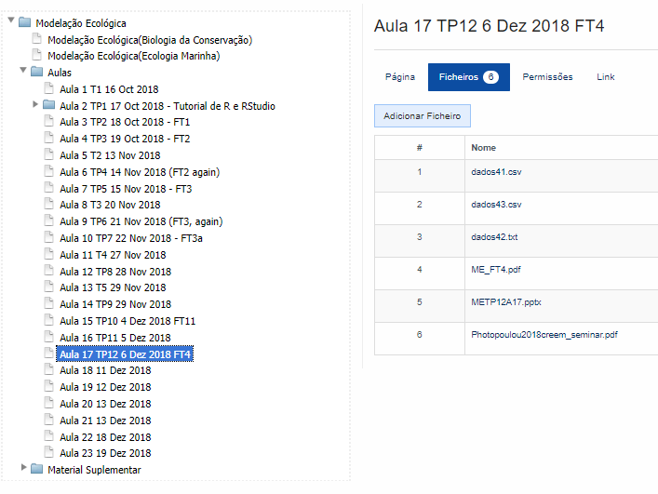
Video no Youtube https://www.youtube.com/watch?v=Kjay1npAaEA&feature=youtu.be

Slide 5
Today’s Menu – original slide
14:00-14:15 – Work to deliver next Tuesday (a week from today!) – groundrules and additional details
14:15-14:30 – Will there be an exam or not. If so, what the exam might be and… what the exam will not be! If not, what will the assessment be like.
And then it might depend on the discussion above – slide will be updated accordingly!
A bit on steady state models?
Look at practicals FT3a and FT11
Groups start working on next Tuesday task!

Slide 6
Today’s Menu – de facto
14:00-14:45 – Work to deliver next Tuesday (a week from today!) – groundrules and additional details
14:45-15:30 – Will there be an exam or not. If so, what the exam might be and… what the exam will not be! If not, what will the assessment be like.
15:30 – 16:00 Intorduction to steady state models
16:00 – 17:00 Groups start working on next Wednesday’s task!

Slide 7
Modelos
de base estatística
Modelos de estado estacionário
Modelos dinâmicos
Caracterizam os estados de interesse
Modelos com base no indivíduo
Modelos de lógica difusa

Slide 8
N015 – 5 alunos
Modelos de estado estacionário
Grupo 1
N030 – 3 alunos
N050 – 4 alunos
Modelos dinâmicos
Grupo 2
N060 – 3 alunos
N070 – 4 alunos
Modelos com base no indivíduo
Grupo 3
N100 – 4 alunos
N140 – 3 alunos
Grupo 4
Modelos de lógica difusa
N160 – 3 alunos
N080 – 2 alunos
Each group will find 1 paper, using said models and with an interesting ecological application and read it
Each of the 4 groups will get together and will make a presentation of 20 minutes and make an up to 6 pages report on these – to be shared between all
Up to 10 mins on the type of models and what they are and can be used for
Up to 10 minutes on the 2 papers chosen
Discuss everything you can think of, from usefulness, to strengths and weaknesses
Team work: symbiosis
Presentation & Delivery : Wednesday 19th December / 31st December

Slide 9
Modelação Ecológica: Assessment
Existing default: Exam 70% and Practical work 30%
Proposal (replace exam with):
Paper writing 10%
Work next Tuesday 25% (10% apresentação + 15% relatório – entrega?)
Congress abstract 25%
Ecological modelling day (preparation) 10%
Proposal only accepted if everyone will agree on it!

Slide 10
Predator-Prey Experience: OUTPUTS
“If you have to do something any way, maximize what you can get out of it!”
– unknown old wise man ☺
Desafios… aceitam?

Slide 11
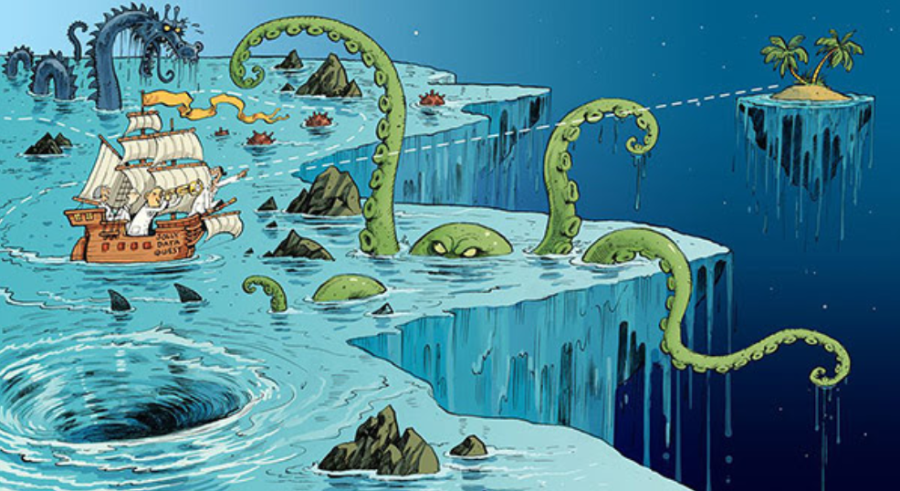
(Illustration by David Parkins in Nature briefing e-mail)

Slide 12
Predator-Prey Experience: OUTPUTS
Tutorial paper – TAM leads
Several congress presentations – students lead
“Ecological Modelling” event at DBA, aimed at 1st and 2nd year biology students – students lead
Any other ideas?

Slide 13
Tutorial Paper
Venue (thinking… MEE? do think about this too!)
Collaboration tool online (Overleaf – I will set it up – add your name please)
Folks with no data – lets collect it (tomorrow 13:00)
Spin?
Who does what?
Analysis
Writing (Introduction, Methods, Results, Discussion)
An R package with data and analysis?
Start sharing your thoughts!

Slide 14
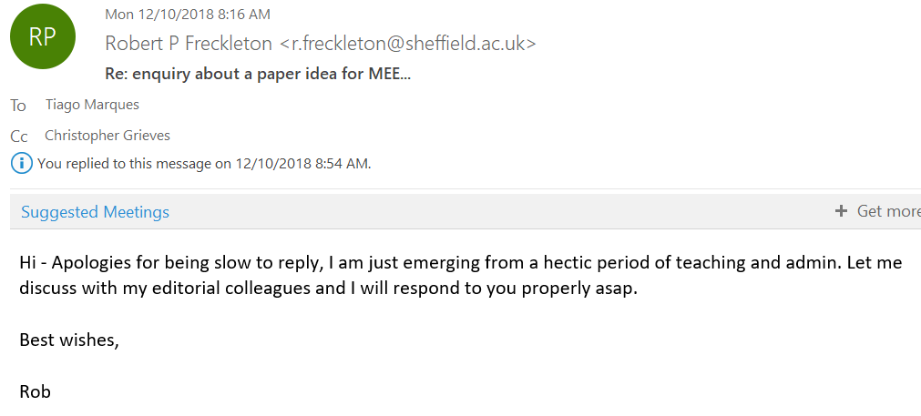
Would MEE be willing to take our paper?

Slide 15
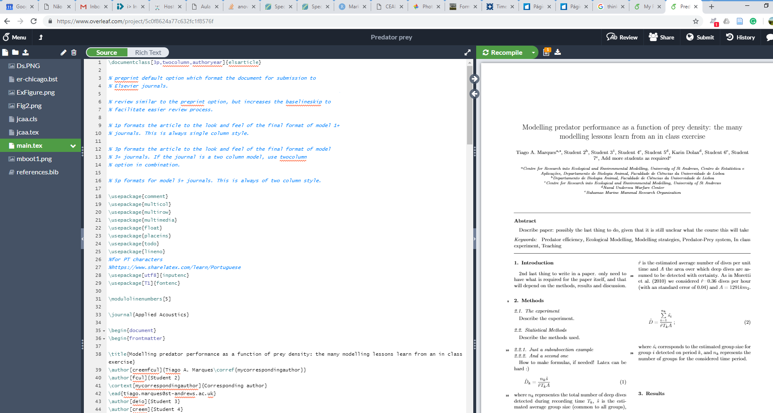
Visit overleaf and look around
https://www.overleaf.com/read/gjpjcwfgdmfq

Slide 16
IWSM – Modelling strategies for an in class experiment
www.iwsm2019.org

Slide 17
Congresso da SPECO – How to model ecological data to derive ecological insights?

Slide 18
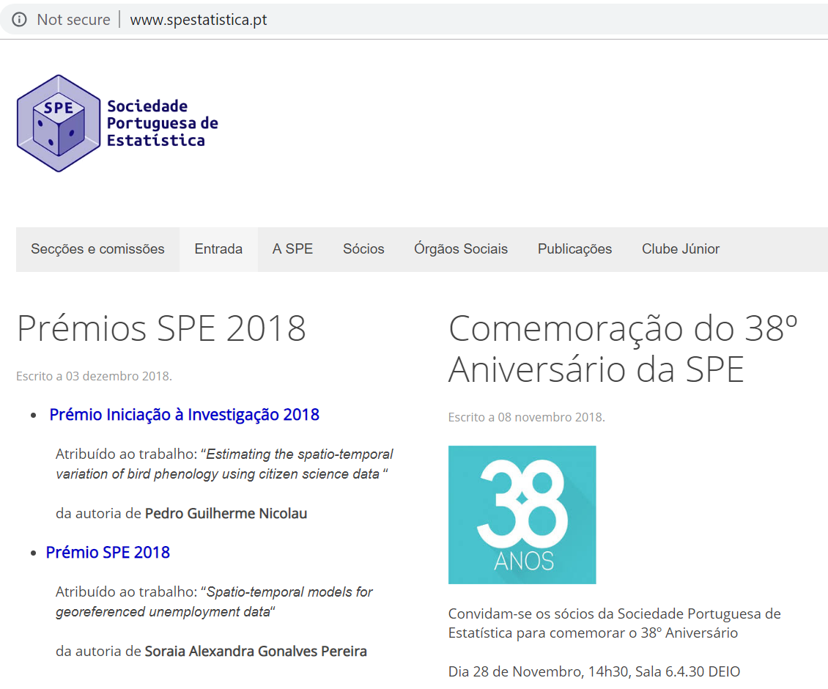
Congresso da SPE – How to teach ecological modelling to students
Amarante…!

Slide 19
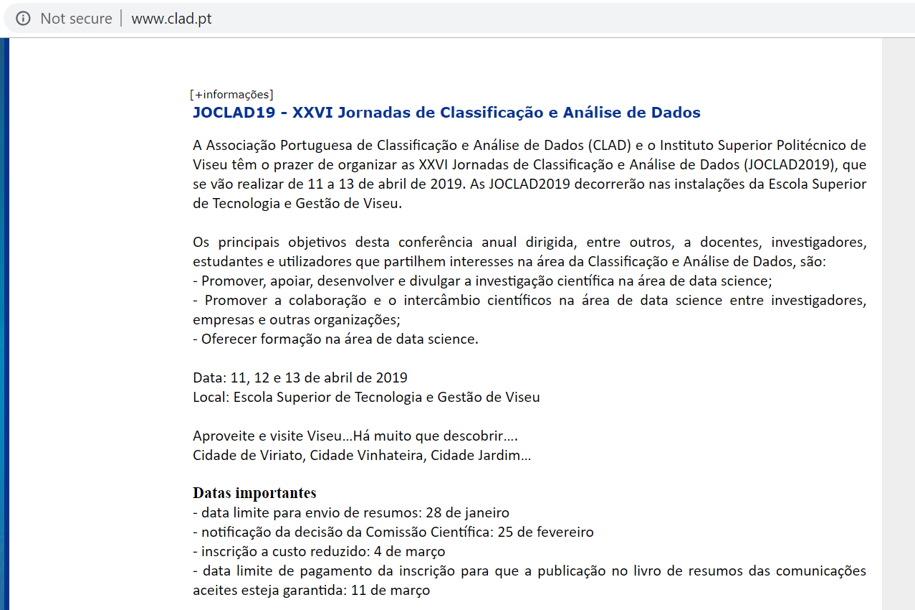
Modelling predator efficiency as a function of prey abundance

Slide 20
SEARCH FOR OTHER VENUES AND THINK ABOUT POSSIBLE TWISTS TO REDUCE OVERLAP IN DIFFERENT TALKS/POSTERS

Slide 21
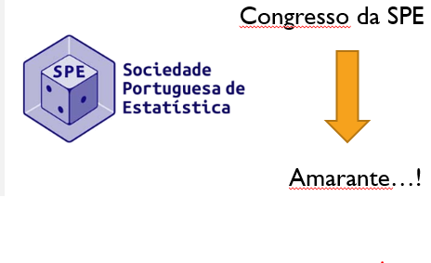
Escolham os grupos: quem fica com qual?

Slide 22
Organize a DAY ON ecological modelling
Aimed at biology students (1st/2nd year) – President of the department on board!
Say one afternoon (when?)
Get a couple of invited speakers
Present our hunter/prey data
Present some of the actual works that students presented for evaluation in Modelação Ecológica
Dedicated tasks (e.g. repeat predator/prey with students?)
Put your thinking cap on

Slide 23
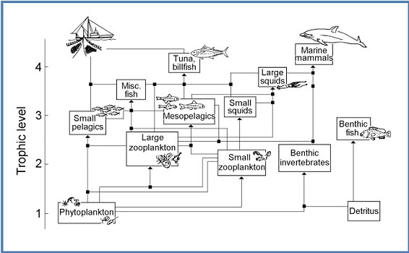
MODELOS DE ESTADOS ESTACIONÀRIOS

Slide 24
DISCLAIMER
Eu não tenho a facilidade ou conhecimento desta classe de modelos que tenho por exemplo nos modelos de base estatística.
Como tal, há coisas que eu pura e simplesmente não sei!
Mas claro, estou aqui para ensinar e ajudar a tentar aprender…

Slide 25
Enquadramento
Os modelos de estado estacionário têm como pressuposto que as variáveis de estado não variam ao longo do período de tempo considerado.
Observações reflectindo variabilidade temporal não são incorporadas nestes modelos.
Em vez disso, são utilizados valores médios e, consequentemente, o modelo dará origem também a estimativas de valores médios.

Slide 26
modelo de estados estacionários
$\frac{∂X}{∂t}$=0
Exemplos de modelos de estados estacionários:
Chemostat ou mixed flow reactor
Modelos de teias tróficas (Ecopath)
Modelos de análise de redes ecológicas

Slide 27
Exemplos de modelos Chemostat ou mixed flow reactor
Input
Meio homogéneo
Output
$\frac{∂C}{∂t}$=$\frac{Input −Output −Decomposition −Settling −Evaporation}{Volume}$
$0$=$\frac{Input −Output −Decomposition −Settling −Evaporation}{Volume}$
$Input$= $Output+Decomposition+Settling+Evaporation$

Slide 28
Exemplos de modelos Chemostat ou mixed flow reactor
Concentração
Tempo
Afinal… não é que os modelos não dependam do tempo, mas assume-se que quando os observamos eles já estabilizaram, ou seja já não há variações nos estados que estamos a modelar

Slide 29
Exemplos de modelos de teias tróficas (Ecopath)

Slide 30
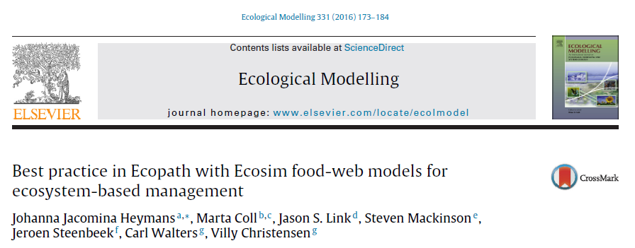

Slide 31
Hummm so you deal with models where time should not be accounted for, yet you use time series models to fit them… what am I missing here? At the very least this seems somewhat schizophrenic!

Slide 32
EwE
Identify and quantify major energy flows in an ecosystem
Describe ecosystem resources and their interactions among species
Evaluate the ecosystems effects of fishing or environmental changes
Explore management options (by incorporating economic, social and ecological considerations of fisheries)
Evaluate the placement and impact of marine protected areas
Predict the bioaccumulation of persistent pollutants
Useful for testing theories about ecosystem resilience, stability and regime shifts

Slide 34
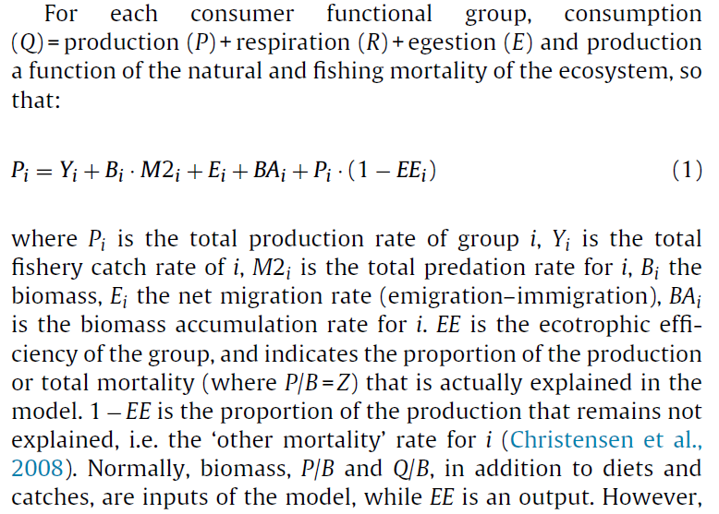

Slide 35
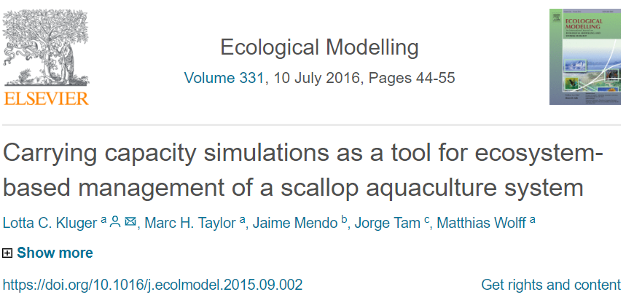
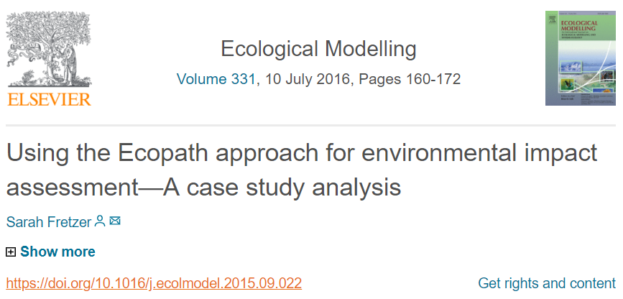
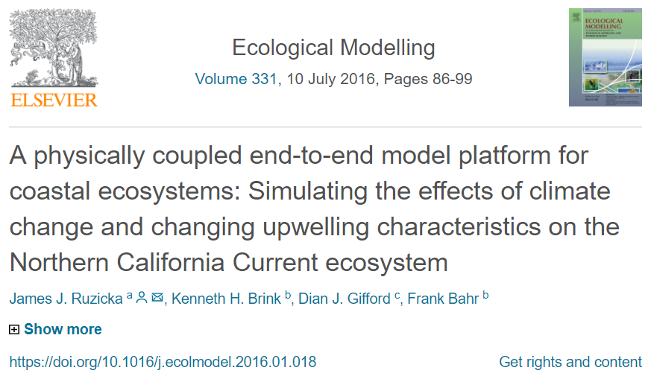
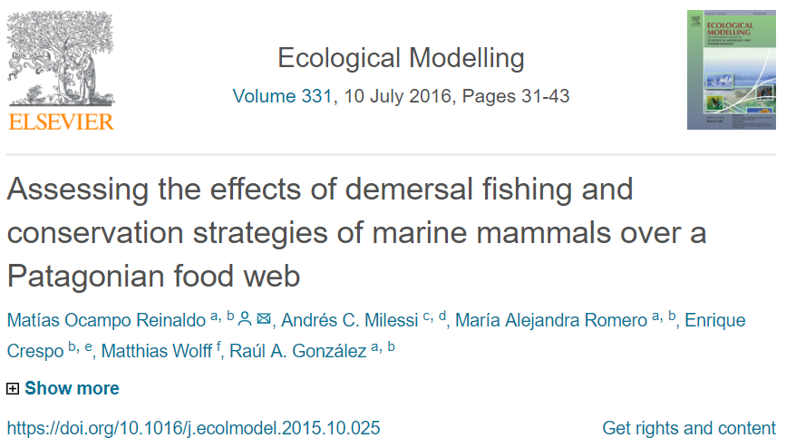
Examples from special Ecopath issue in ecological modelling: available in FENIX!

Slide 36
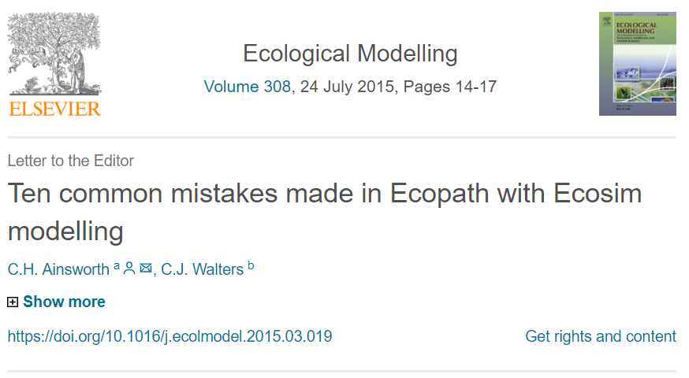
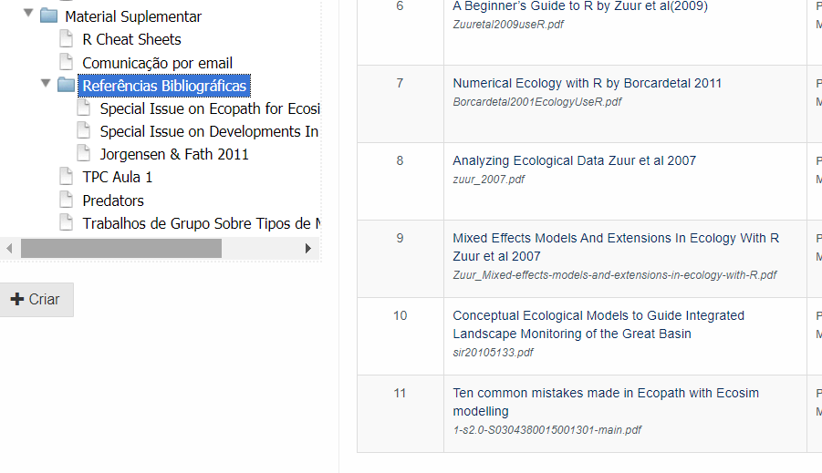

Slide 37
An R Implementation
And that is what we might do in the practical (FT5, maybe tomorrow!)

Slide 38
Now, groups, get your act together!

